Slide 1


Sagar Virani
21th August 2022

Slide 2

Outline
Executive Summary
Introduction
Methodology
Results
Conclusion
Appendix

Slide 3
Executive Summary
Summary of methodologies
Data Collection
Data Wrangling
Exploratory Data Analysis with SQL
Exploratory Data Analysis with Data Visualization
Interactive Visual Analytics with Folium
Interactive Visual Dashboard with Plotly Dash
Predictive analysis using Machine Learning
Summary of all results
Exploratory Data Analysis results
Interactive analytics
Predictive Analytics

Slide 4
Introduction
Project background
Space X advertises Falcon 9 rocket launches on its website with a cost of 62 million dollars; other providers cost upward of 165 million dollars each, much of the savings is because Space X can reuse the first stage. Therefore, if we can determine if the first stage will land, we can determine the cost of a launch. This information can be used if an alternate company wants to bid against space X for a rocket launch.
Problems you want to find answers
To create a machine learning pipeline to predict if the first stage will land successfully or not?
Determine what factors will affect the successful rocket landing?
The interaction amongst various features that determine the success rate of a successful landing.
What operating conditions needs to be in place to ensure a successful landing program.

Slide 5


Slide 6
Methodology
Executive Summary
Data collection methodology:
SpaceX REST API
Web scraping from Wikipedia
Perform data wrangling
Data cleaning of null values and removal of irrelevant columns
One-hot encoding was applied to categorical features
Perform exploratory data analysis (EDA) using visualization and SQL
Perform interactive visual analytics using Folium and Plotly Dash
Perform predictive analysis using classification models
LR, KNN, SVM and DT models have been built and evaluated for the best classifier

Slide 7
Data Collection
The following data set was collected:
SpaceX launch data was collected using REST SpaceX API.
The data includes information about the rocket used, payload delivered, launching specifications, landing specifications and landing outcome.
The SpaceX REST API endpoints, or URL, starts with api.spacexdata.com/v4/.
In addition, the data was collected through web scraping from Wikipedia pages for Falcon 9 launch records.
This records were extracted by parsing HTML table and converted it to a pandas dataframe using BeautifulSoup.

Slide 8
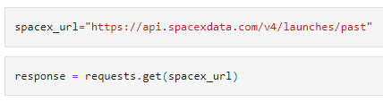
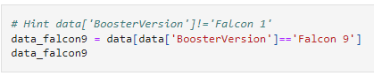
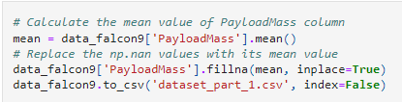
Data Collection – SpaceX API
1. Requesting rocket launch data from SpaceX API
SpaceX REST API was used to collect data. After collection, the requested data was cleaned, and some basic data wrangling and formatting was applied.
The link to the notebook is https://github.com/sagarvirani/SpaceX-Project/blob/main/notebook_Falcon9_Data_Collection_API.ipynb
2. Data Cleaning – Filtering Falcon 9 data
3. Data Cleaning – Dealing with NULL values

Slide 9
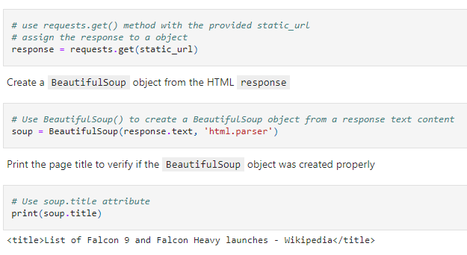
Data Collection - Scraping
Falcon 9 launch records were extracted from Wikipedia pages using web scraping with BeautifulSoup.
The data from table was parsed and converted it into a pandas dataframe.
The link to the notebook is https://github.com/sagarvirani/SpaceX-Project/blob/main/notebook_Falcon9_Data_Collection_Web_Scrapping.ipynb
Web Scrapping using BeautifulSoup

Slide 10
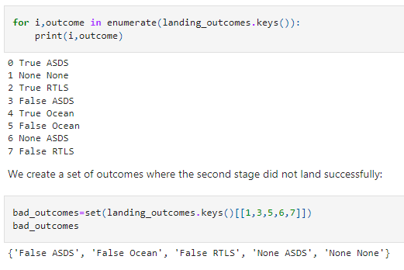
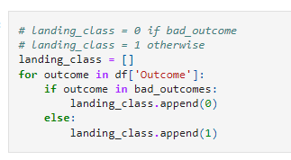
Data Wrangling
1. No. & occurrence of mission outcome per orbit type
Exploratory data analysis was performed, and the training labels were determined.
The link to the notebook is https://github.com/sagarvirani/SpaceX-Project/blob/main/notebook_Falcon_9_Data_Wrangling.ipynb
2. Labelled landing outcome

Slide 11
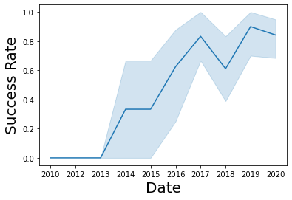
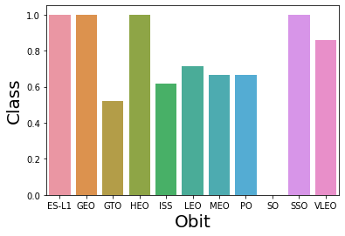
EDA with Data Visualization
Data was explored visually to determine the relationship between flight number and launch Site, payload and launch site, success rate of each orbit type, flight number and orbit type, the launch success yearly trend.
The link to the notebook is https://github.com/sagarvirani/SpaceX-Project/blob/main/notebook_Falcon_9_EDA_Visualization.ipynb

Slide 12
EDA with SQL
The SpaceX dataset was loaded into a PostgreSQL database.
SQL queries were fired upon the dataset to get insight about the data:
The names of unique launch sites in the space mission.
The total payload mass carried by boosters launched by NASA (CRS)
The average payload mass carried by booster version F9 v1.1
The total number of successful and failure mission outcomes
The failed landing outcomes in drone ship, their booster version and launch site names.
The link to the notebook is https://github.com/sagarvirani/SpaceX-Project/blob/main/notebook_Falcon_9_EDA_SQL.ipynb

Slide 13
Build an Interactive Map with Folium
All launch sites were marked, and map objects such as markers, circles, lines were added to mark the success or failure of launches for each site on the folium map.
The feature launch outcomes (failure or success) was assigned to class 0 and 1.i.e., 0 for failure, and 1 for success.
Using the color-labeled marker clusters, which launch sites have relatively high success rate were identified.
Later, the distances between a launch site to its proximities were calculated. The answers to following questions were observed on the map:
Are launch sites near railways, highways and coastlines.
Do launch sites keep certain distance away from cities.
The link to the notebook is https://github.com/sagarvirani/SpaceX-Project/blob/main/notebook_Falcon_9_EDA_Visualization_Folium.ipynb

Slide 14
Build a Dashboard with Plotly Dash
An interactive dashboard was built with Plotly Dash.
Pie charts showing the total launches by a certain sites and scatter graph showing the relationship with Outcome and Payload Mass (Kg) for the different booster version were plotted.
The link to the notebook is https://github.com/sagarvirani/SpaceX-Project/blob/main/notebook_Falcon_9_EDA_Visualization_Dash.ipynb

Slide 15
Predictive Analysis (Classification)
The data of Falcon9 collected was transformed first and then splitted into training and testing set.
Different machine learning models were built and tuned for different hyperparameters using GridSearchCV.
Accuracy of each model was calculated, and the best performing classification model was found.
The link to the notebook is https://github.com/sagarvirani/SpaceX-Project/blob/main/notebook_Falcon_9_Machine_Learning_Prediction.ipynb

Slide 16
Results
Exploratory data analysis results
Interactive analytics demo in screenshots
Predictive analysis results

Slide 17


Slide 18
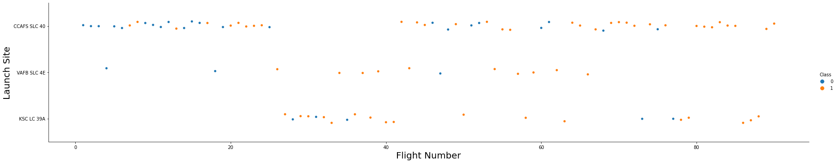

Flight Number vs. Launch Site
Larger the flight amount at a launch site, the greater the success rate at a launch site.

Slide 19
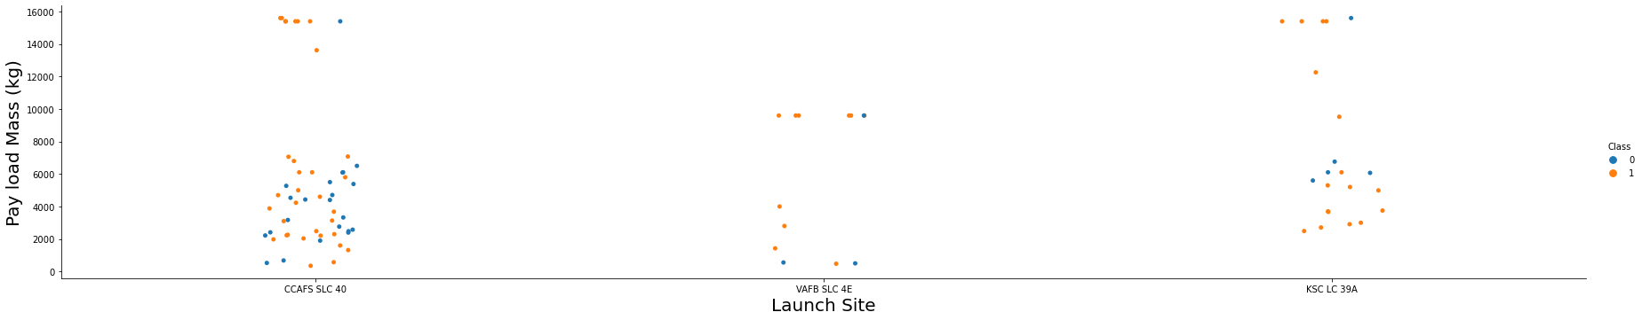
Payload vs. Launch Site
Greater the Payload Mass (launch site CCAFS SLC 40 & KSC LC 39A ) the higher the success rate for the successful landing.

Slide 20
Success Rate vs. Orbit Type
ES-L1, GEO, HEO, SSO, VLEO had the most success rate.

Slide 21
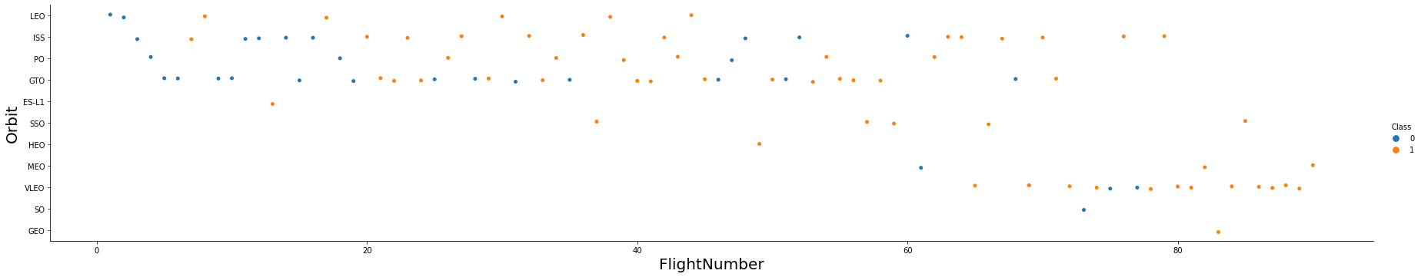
Flight Number vs. Orbit Type
In LEO orbit the success rate is related to the no. of flights whereas, in GTO orbit, there is no such relationship.

Slide 22
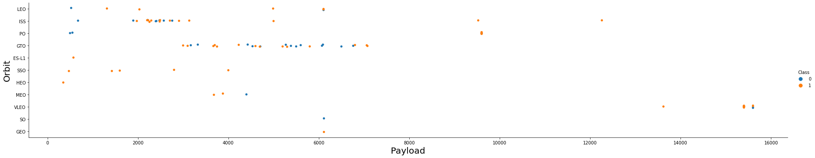
Payload vs. Orbit Type
For Polar , LEO and ISS orbits with heavy payloads the success rate of landing is more whereas for GTO orbit we cannot distinguish this.

Slide 23
Launch Success Yearly Trend
Success rate since 2013 kept on increasing till 2020.

Slide 24
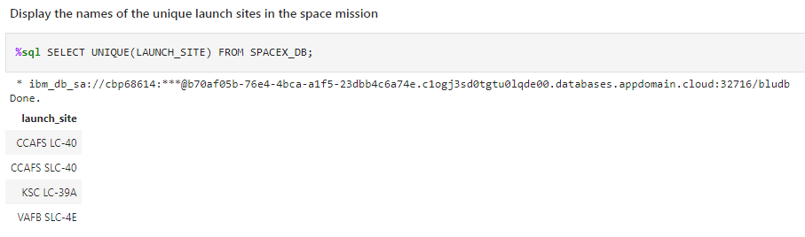
All Launch Site Names

Slide 25
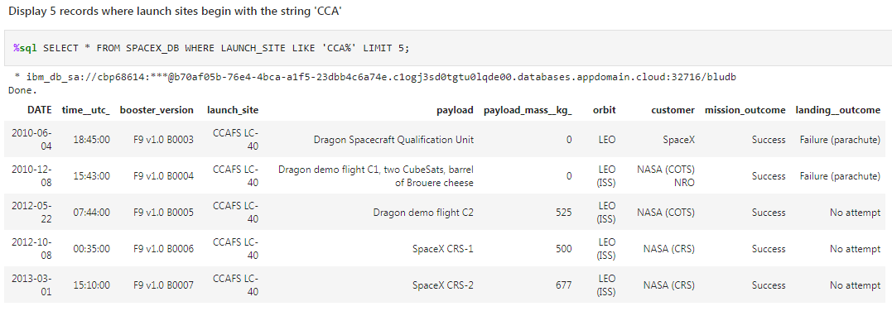
Launch Site Names Begin with 'CCA'
The result is limited to 5 records only.
25

Slide 26
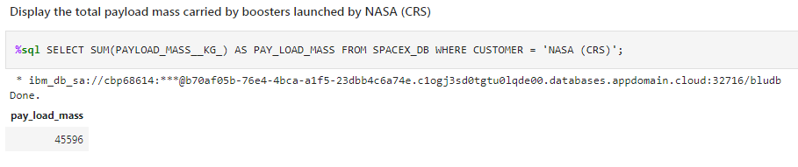
Total Payload Mass
The result is calculated for NASA (CRS) only.

Slide 27
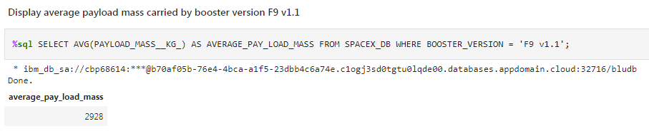
Average Payload Mass by F9 v1.1

Slide 28
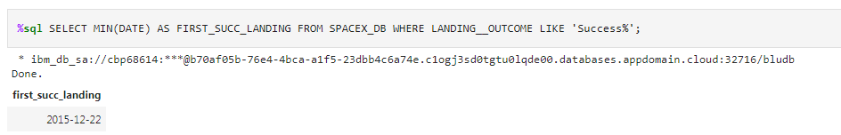
First Successful Ground Landing Date

Slide 29
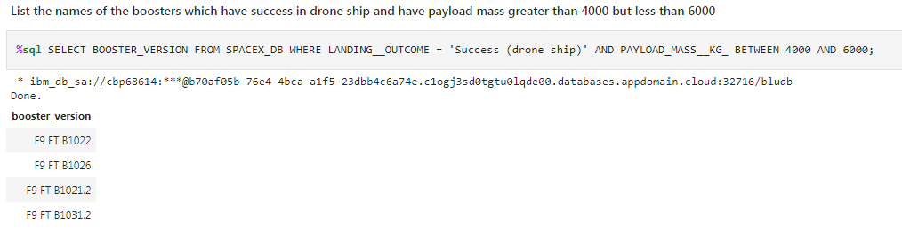
Successful Drone Ship Landing with Payload between 4000 and 6000

Slide 30
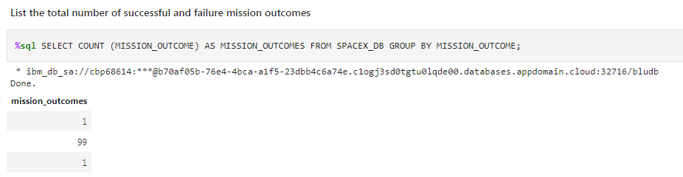
Total Number of Successful and Failure Mission Outcomes
Total successful outcomes are 100 (99+1) and unsuccessful outcome is 1.

Slide 31
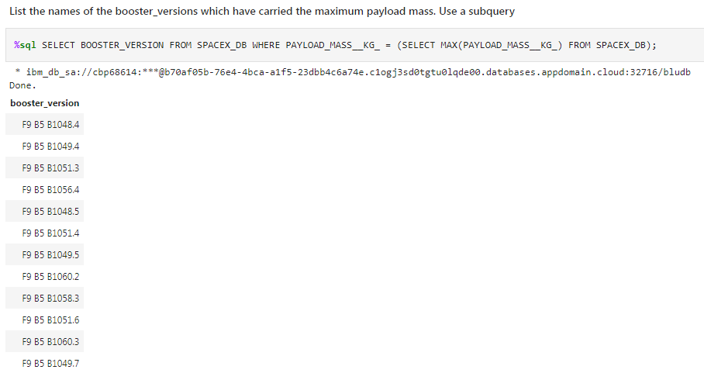
Boosters Carried Maximum Payload

Slide 32
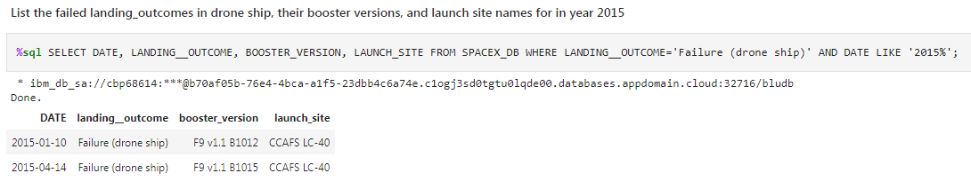
2015 Launch Records

Slide 33
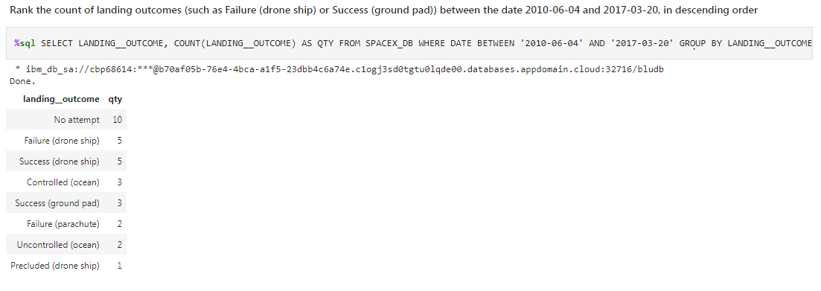
Rank Landing Outcomes Between 2010-06-04 and 2017-03-20

Slide 34


Slide 35

All launch sites global map markers
35

Slide 36

Markers showing launch sites with color labels
36

Slide 37

Launch Site distance to landmarks
37

Slide 38


Slide 39

Pie chart showing the success percentage achieved by each launch site
39

Slide 40

Pie chart showing the Launch site with the highest launch success ratio
40

Slide 41

Scatter plot of Payload vs Launch Outcome for all sites, with different payload selected in the range slider

Slide 42


Slide 43
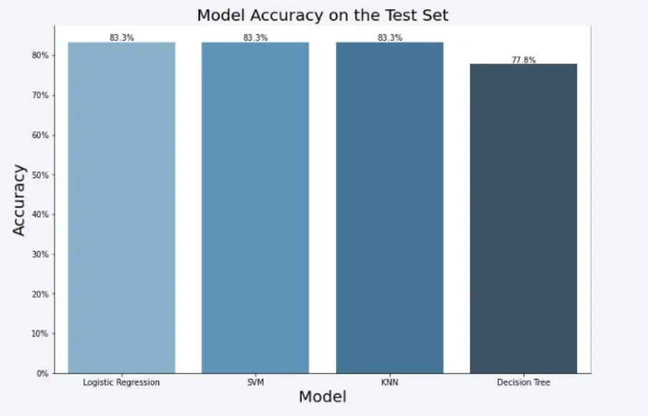
Classification Accuracy
The LR, SVM and KNN models are best in terms of accuracy.

Slide 44

Confusion Matrix
The major problem is the false positives .i.e., unsuccessful landing marked as successful landing by the classifier.
44

Slide 45
Conclusions
We can conclude that:
The larger the flight amount at a launch site, the greater the success rate at a launch site.
Launch success rate started to increase in 2013 till 2020.
Orbits ES-L1, GEO, HEO, SSO, VLEO has best success rate.
KSC LC-39A had the most successful launches of any sites.
The SVM, KNN and Logistic regression models are best in terms of accuracy for the given data set.

Slide 46


